Slide 1
Νέα κοινότητας ownCloud
Ευστάθιος Ιωσηφίδης
iosifidis@opensuse.org
Notes:
Welcome everybody

Slide 2
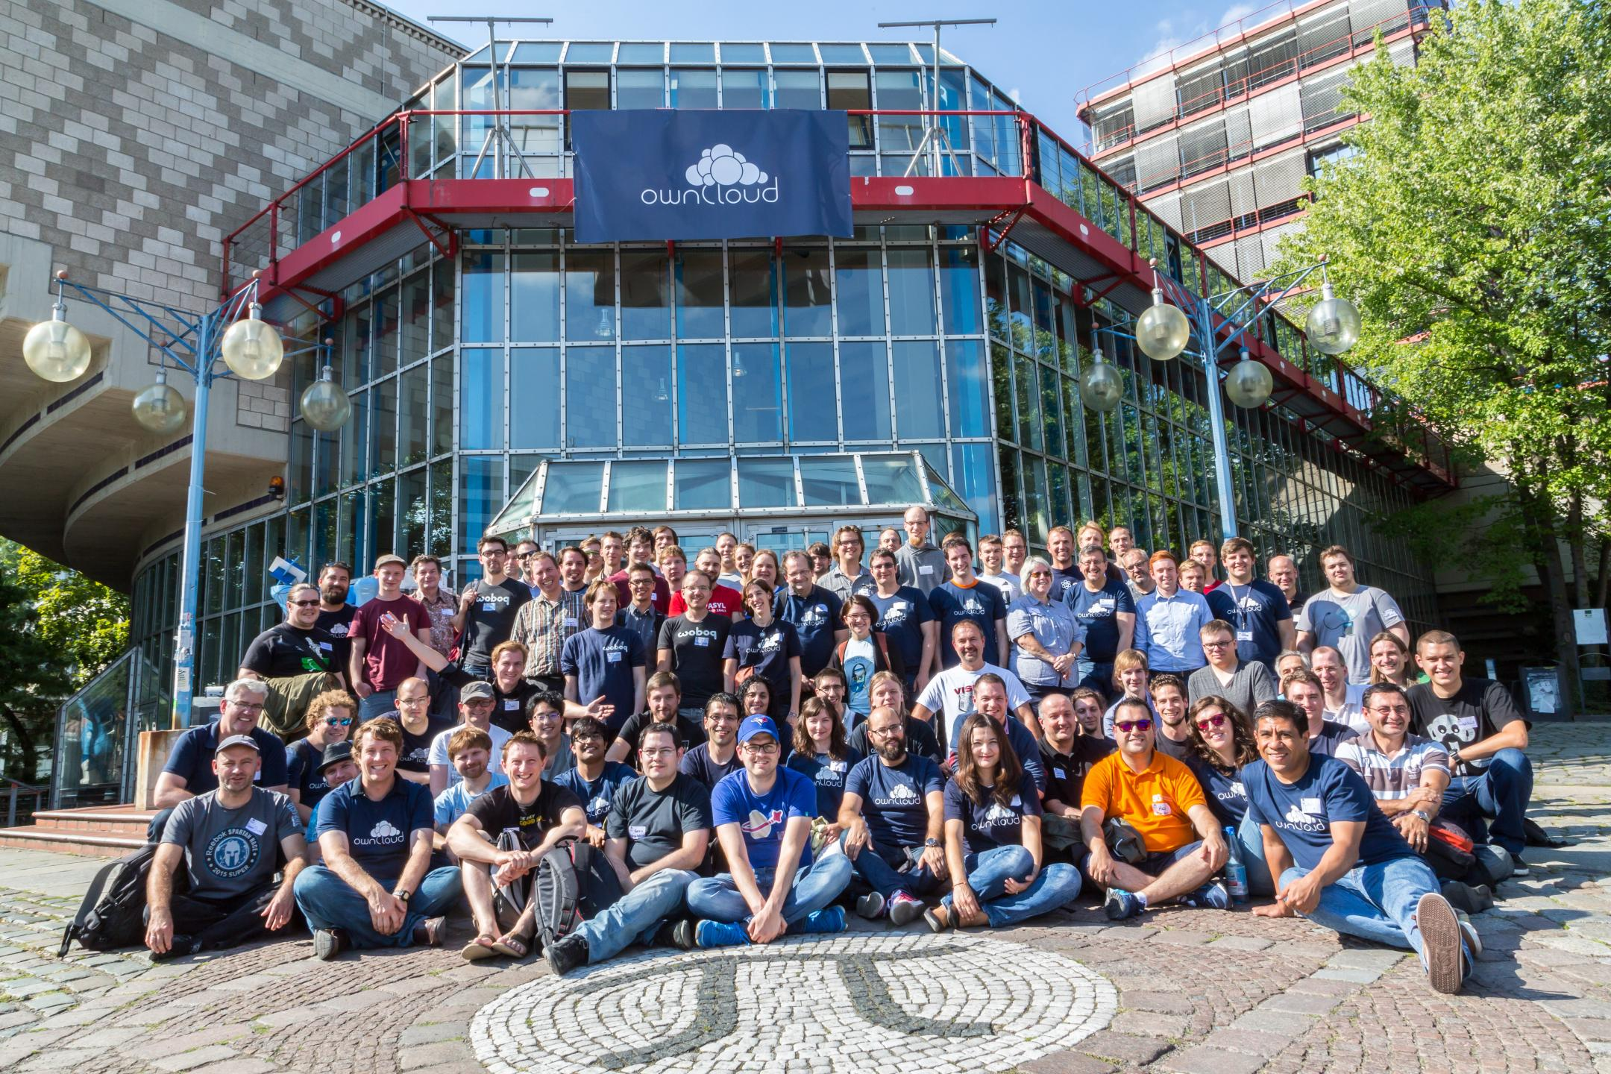
Notes:
Good and bad of cloud
Value of privacy
And what you can do to protect it
40 minutes
Interrupt with questions

Slide 3
Agenda
User Data Manifesto 2.0
Security Bug Bounties
ownCloud Proxy
Notes:
Good and bad of cloud
Value of privacy
And what you can do to protect it
40 minutes
Interrupt with questions

Slide 4
User Data Manifesto 2.0
Notes:
Start with the awesomeness of the cloud. Do I need to tell you?

Slide 5
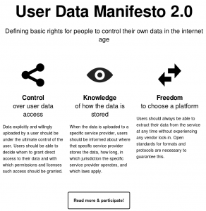
User Data Manifesto 2.0
https://userdatamanifesto.org/
Control over user data access
Knowledge of how the data is stored
Freedom to choose a platform
It aims to define basic rights for people to control their own data in the Internet age
The User Data Manifesto is supported and endorsed by major organizations supporting digital freedoms like the Free Software Foundation Europe, spreed, the X-Lab, the GNOME Foundation, KDE e.V., ToS;DR and many others.
Notes:
Android phone breaks – log in on new
Games online
Chatting, sharing pics or documents with others
Free or cheap!

Slide 6
Security Bug Bounties
Notes:
Last point – price. How do we pay?
Bad side of the cloud.

Slide 7
Security Bug Bounties
No technology is perfect
ownCloud Security Bug Bounty Program rewards security researchers for finding issues in the ownCloud Server, and in so doing helps strengthen ownCloud Server for customers, users and the community.
Notes:
Ask yourself these questions.

Slide 8
Security Bug Bounties
When a security bug is identified, it can be submitted via our HackerOne page (https://hackerone.com/owncloud).
If the bug is identified as meaningful and qualifies for the program, and the submitter has followed the Disclosure Policy, the bug bounty is paid out relative to bug severity. Highest severity issues like ones which give the adversary complete control over a server result in up to USD $ 500 reward while low and medium severity problems have rewards ranging from $50 to $250.
Notes:
Ask yourself these questions.

Slide 9
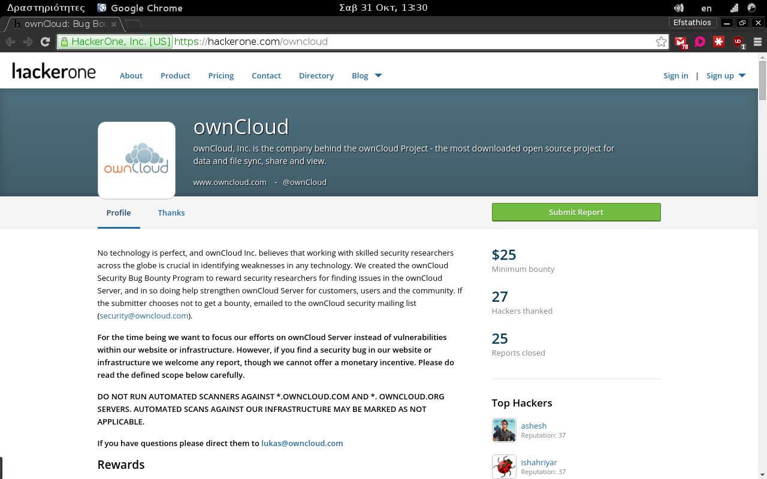
Security Bug Bounties
Notes:
Ask yourself these questions.

Slide 10
ownCloud Proxy
Notes:
Why it matters? Privacy, just that.

Slide 11
ownCloud Proxy
Simply put, ownCloud Proxy enables you to take a laptop and an Internet connection, connect to your privately hosted ownCloud from anywhere, without requiring you to make any changes to your local network settings – no router configuration, no DNS entries, no domain name registration. The ownCloud Proxy service relies on a partner who provides the service for a fee. Right now, there is one partner, pageKite.
https://owncloud.org/connect/
Notes:
I have nothing to hide.
Well, you do. And you should. Besides, this isn't even the right argument to have.
Let's go over these three points

Slide 12
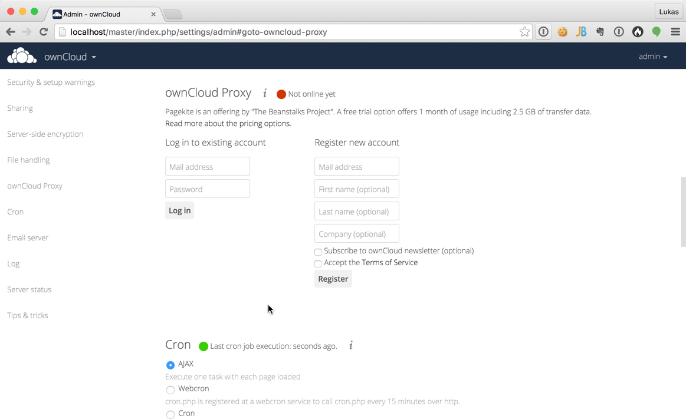

Slide 13
That's it!

Slide 14
Icons

